Slide 1
Local Features
By:
Ofer Spiegel
Tzviki Fisher
Lecturer: Prof. Hagit Hel-Or

Slide 2
Outline
2D – feature based alignment
Image Point Matching Problem
Least squares and iterative algorithm
Application: Panography
Demo
SIFT
Results and Demo
HOG
RANSAC

Slide 3
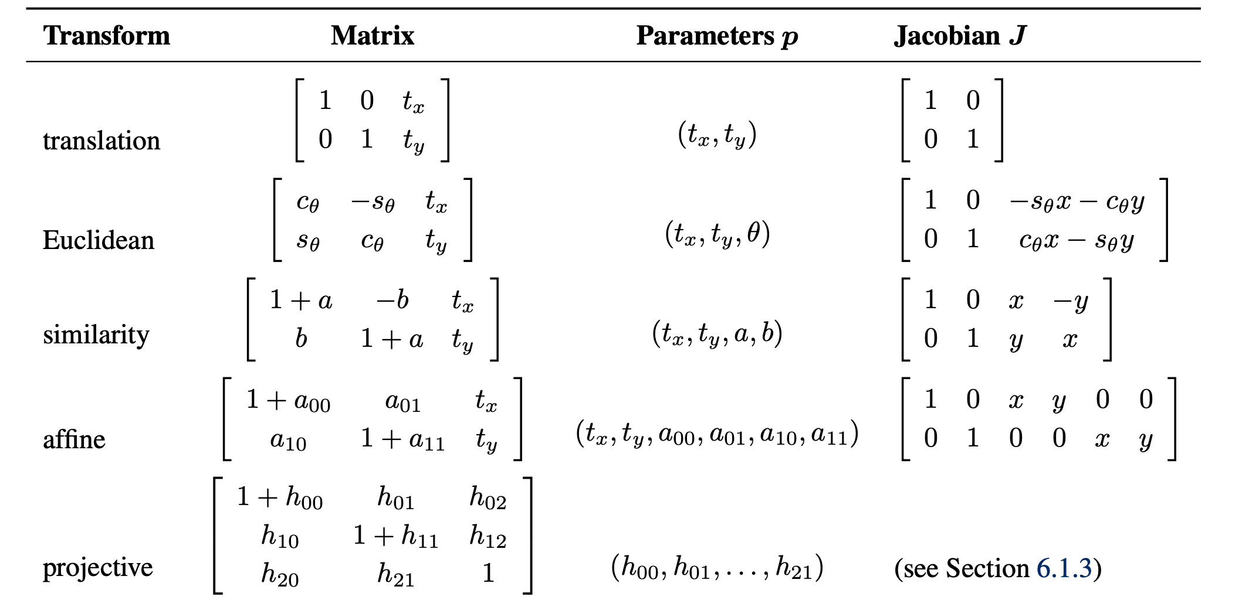
Image Point Matching Problem

Slide 4
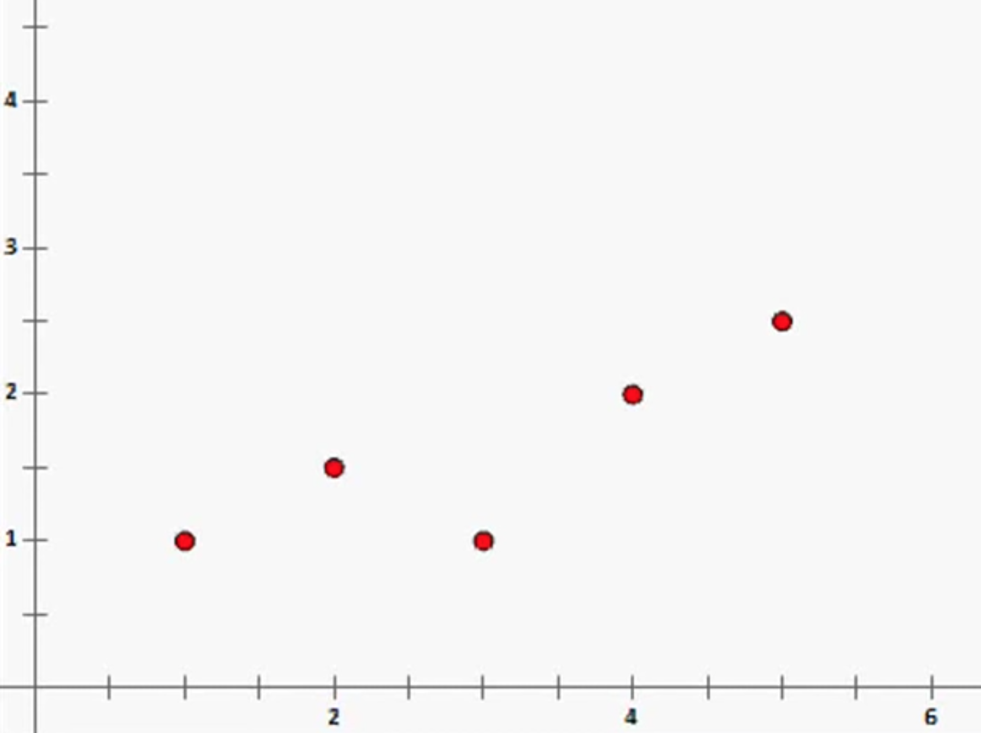
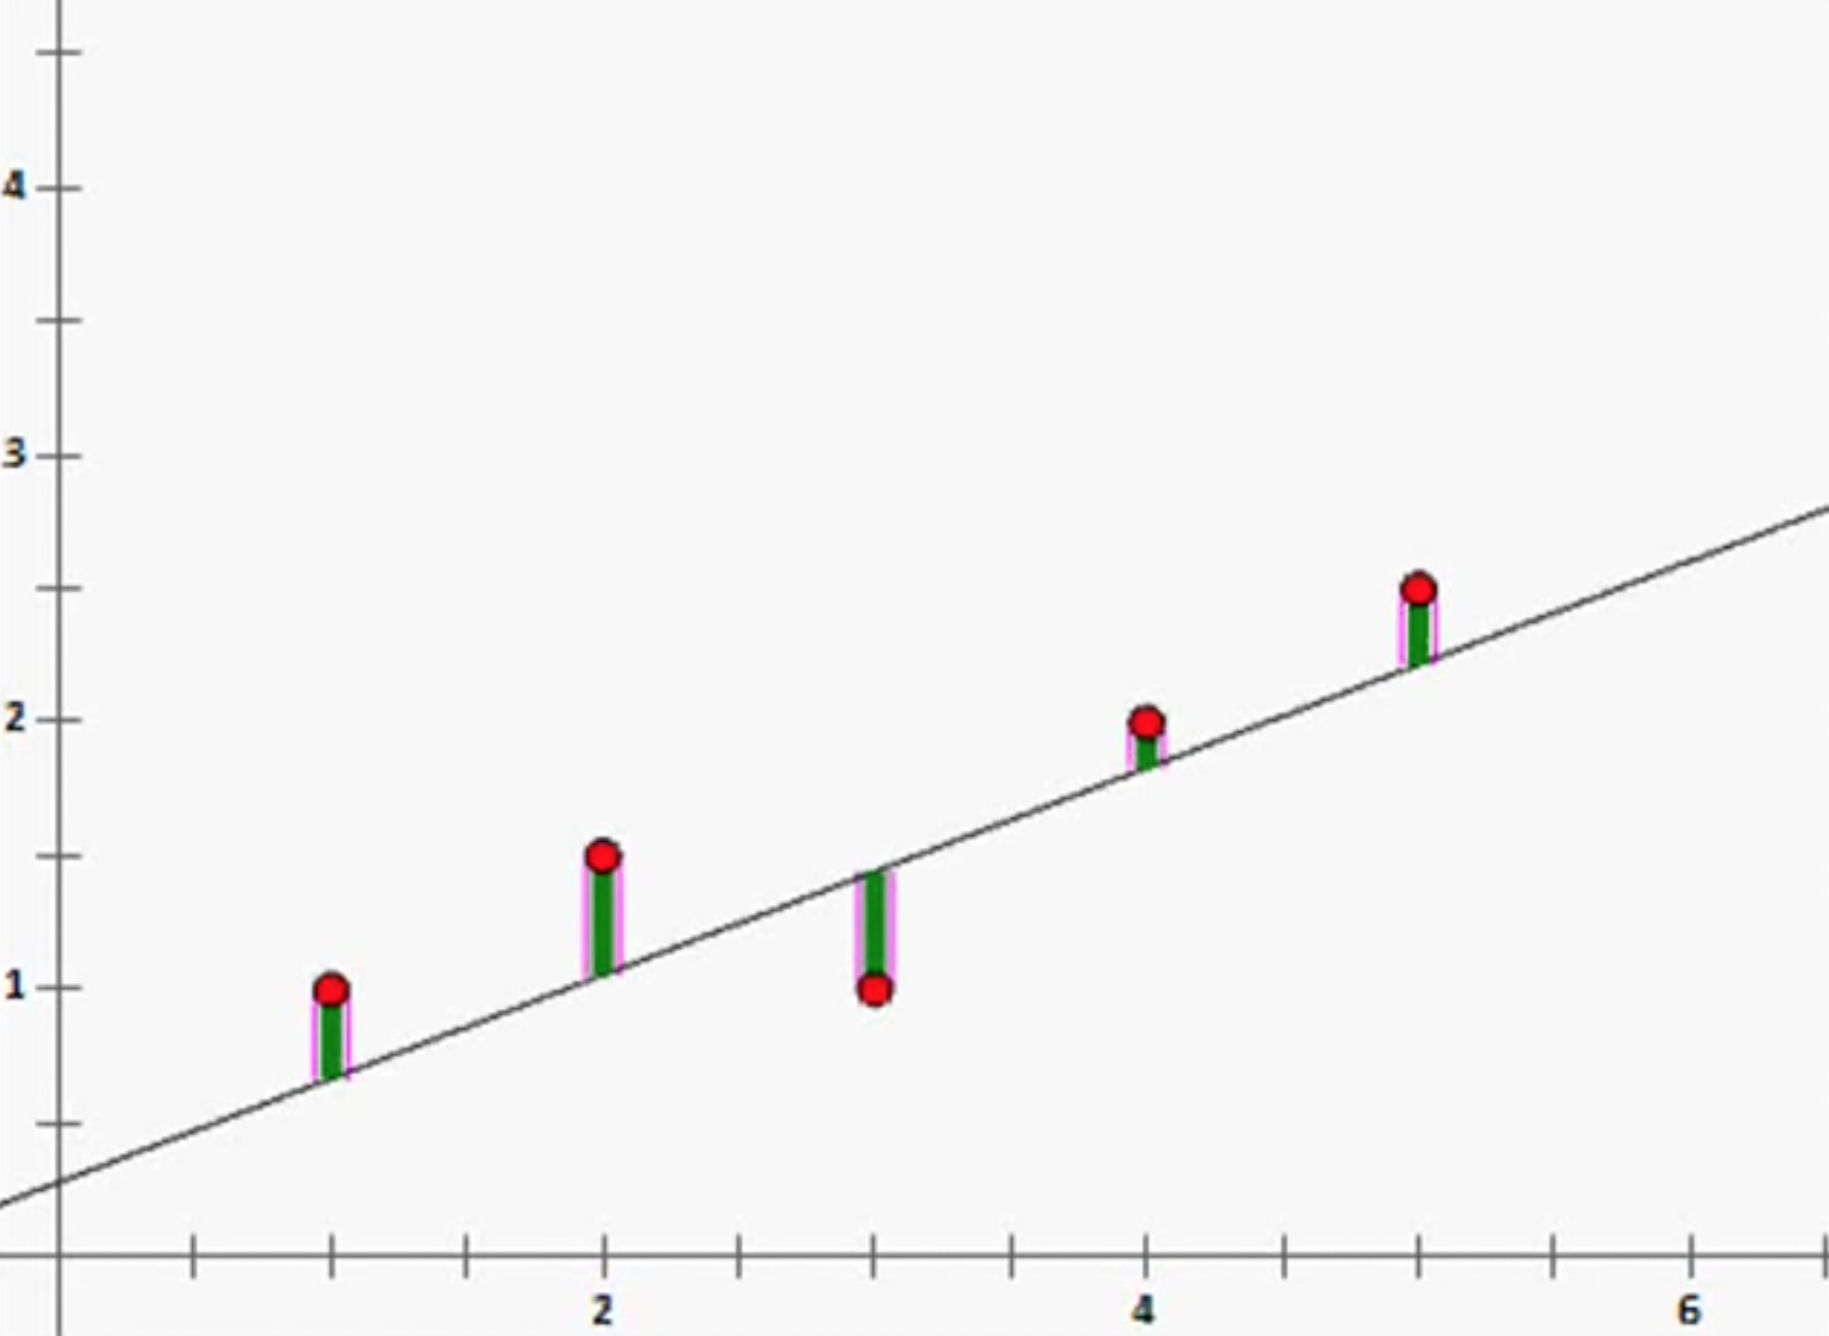
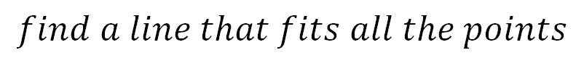
Least Squares Mean
$$find a line that fits all the points$$
No exact solution

Slide 5
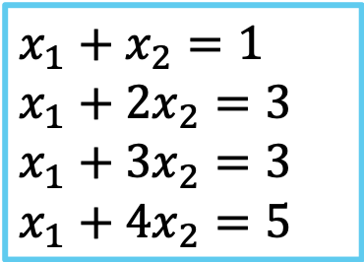
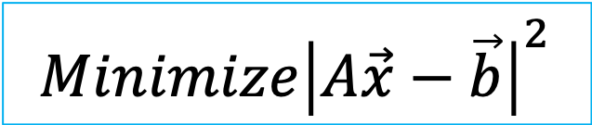
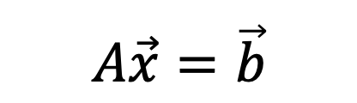
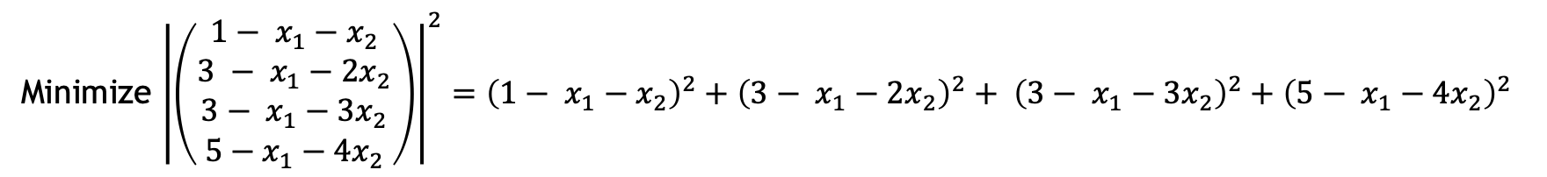
Least Squares Mean
$$x_{1}+x_{2}=1$$
$$x_{1}+{2x}_{2}=3$$
$$x_{1}+{3x}_{2}=3$$
$$x_{1}+{4x}_{2}=5$$
No exact solution
$$A\vec{x}=\vec{b}$$
$$Minimize{\left|A\vec{x}−\vec{b}\right|}^{2}$$
Minimize ${\left|\left(\begin{aligned}{1− x}_{1}−x_{2} \\ 3 − x_{1}−{2x}_{2} \\ {3− x}_{1}−{3x}_{2} \\ {5−x}_{1}−{4x}_{2}\end{aligned}\right)\right|}^{2}={\left({1− x}_{1}−x_{2}\right)}^{2}+{\left({3− x}_{1}−2x_{2}\right)}^{2}+ {\left({3− x}_{1}−3x_{2}\right)}^{2}+{\left({5− x}_{1}−4x_{2}\right)}^{2}$

Slide 6


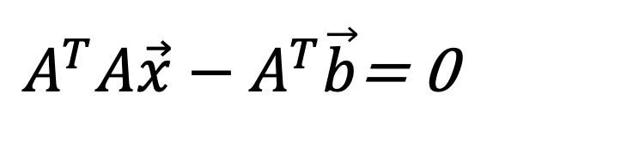
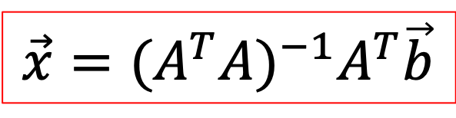
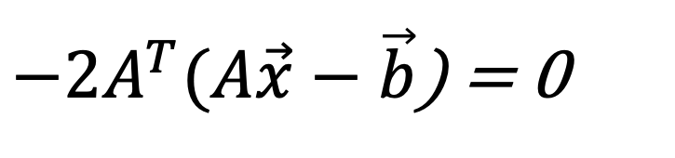
Least Squares Mean
$$Calculus$$
$$Minimize{\left|A\vec{x}−\vec{b}\right|}^{2}$$
$−2A^{T}(A\vec{x}−\vec{b}$) = 0
Take derivitive wrt x
$A^{T}A\vec{x}−A^{T}\vec{b}$= 0
$$\vec{x}=({A^{T}A)}^{−1}A^{T}\vec{b}$$

Slide 7
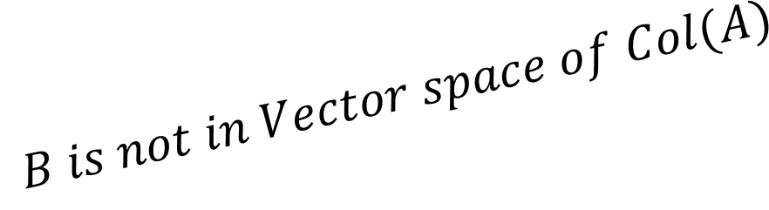


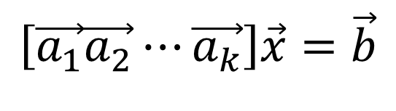

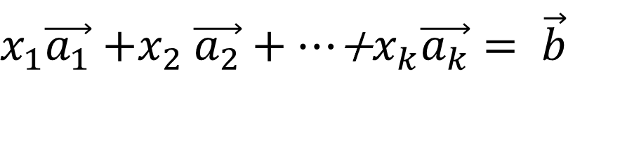
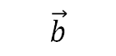
Least Squares Mean
$$A\vec{x}=\vec{b}$$
$$Geometry$$
$$\left[\vec{a_{1}}\vec{a_{2}}⋯\vec{a_{k}}\right]\vec{x}=\vec{b}$$
$x_{1}\vec{a_{1}}{+x}_{2}\vec{a_{2}}+⋯$+$x_{k}\vec{a_{k}}= \vec{b}$
$$\vec{b}$$
Col(A)
$\vec{x}$ = ???
$$B is not in Vector space of Col(A)$$

Slide 8
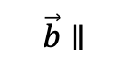

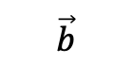
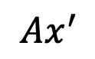

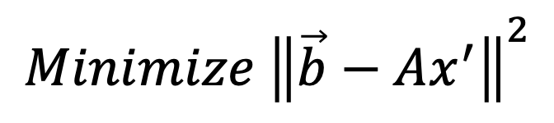

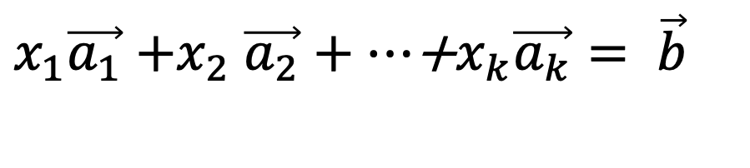
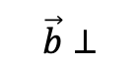
Least Squares Mean
$$with Geometry$$
$x_{1}\vec{a_{1}}{+x}_{2}\vec{a_{2}}+⋯$+$x_{k}\vec{a_{k}}= \vec{b}$
$$Minimize {\left\|\vec{b}−Ax^{′}\right\|}^{2}$$
$$\vec{b}⊥$$
$$\vec{b}$$
Col(A)
$$\vec{b}∥$$
$$How?$$
$$Ax^{′}$$
= Proj $\vec{b} on Col(A)$

Slide 9
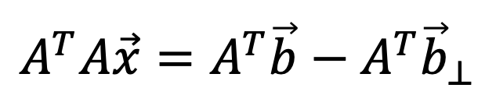
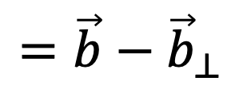
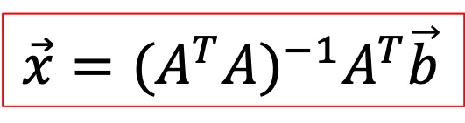
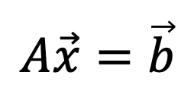
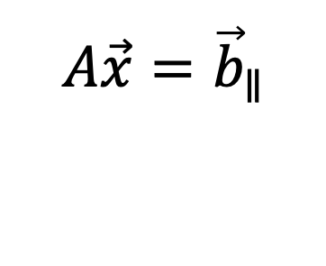
Least Squares Mean
$$with Geometry$$
$$A\vec{x}=\vec{b}$$
$$A\vec{x}={\vec{b}}_{∥}$$
$$=\vec{b}−{\vec{b}}_{⊥}$$
$$A^{T}A\vec{x}=A^{T}\vec{b}−A^{T}{\vec{b}}_{⊥}$$
$$\vec{x}=({A^{T}A)}^{−1}A^{T}\vec{b}$$
pseudoinverse(A)

Slide 10
We want local features
Goal: Find points in an image that can be:
Found in other images
Found precisely – well localized
Found reliably – well matched

Slide 11
We want local features
Why?
Want to compute fundamental matrix recover geometry
Robotics/Vision: See how a bunch of points move from one frame to another. Allows computation of how camera moved->depth->moving objects.
Build a Panorama…

Slide 12
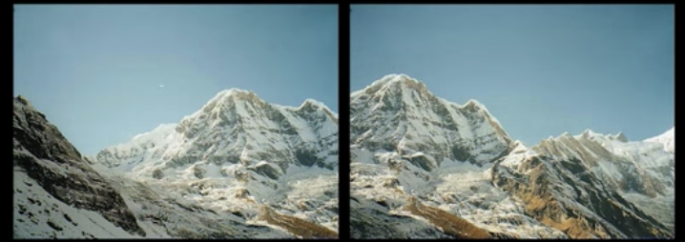
How do we build Panorama?
We need to match(align) images

Slide 13
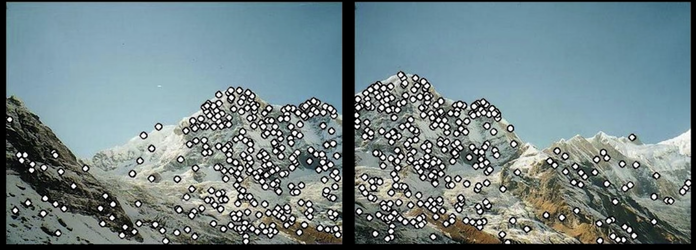
How do we build Panorama?
Detect features(feature points) in both images

Slide 14
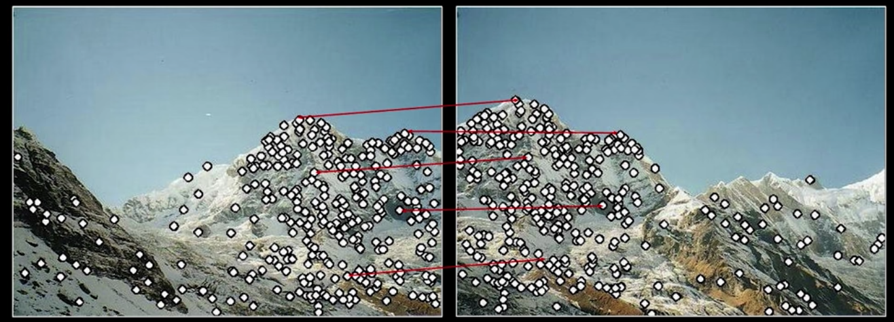
How do we build Panorama?
Detect features(feature points) in both
Match features – find corresponding pairs

Slide 15
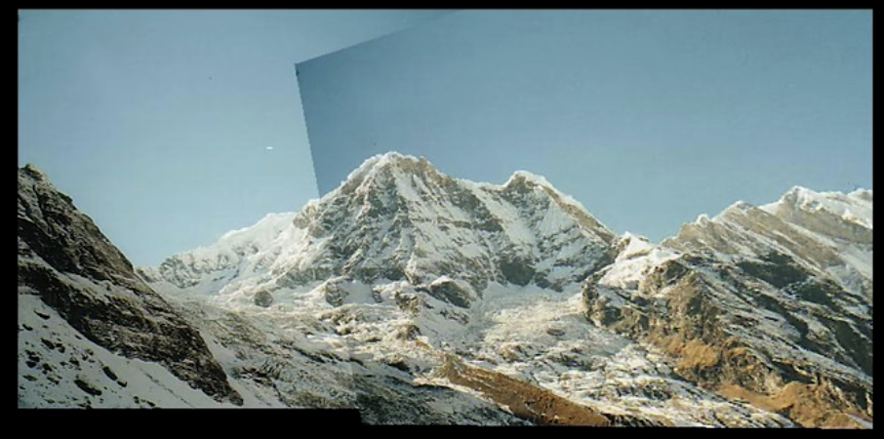
How do we build Panorama?
Detect features(feature points) in both
Match features – find corresponding pairs
Use this pairs to align images
Can use IP methods for cleaning the image

Slide 16
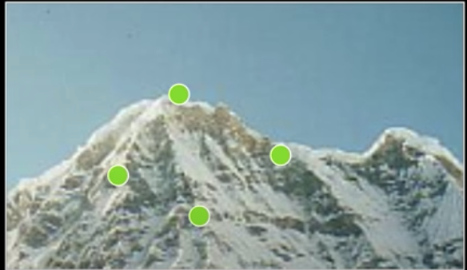
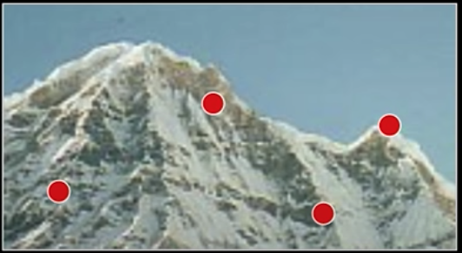
Matching with features
Problem 1
Detect the same point independently in both
No chance to match!
We need repeatable detector

Slide 17

Matching with features
Problem 2
For each point correctly recognize the corresponding one
We need reliable and distinctive descriptor

Slide 18
More Motivation…
Feature points are also used for:
Image alignment(e.g homography)
3D construction
Motion tracking
Object recognition
Indexing and database retrieval
Robot navigation
Other…

Slide 19



Corner Detection: basic idea
Flat region: no change
Edge:
no change
Corner:
significat change

Slide 20
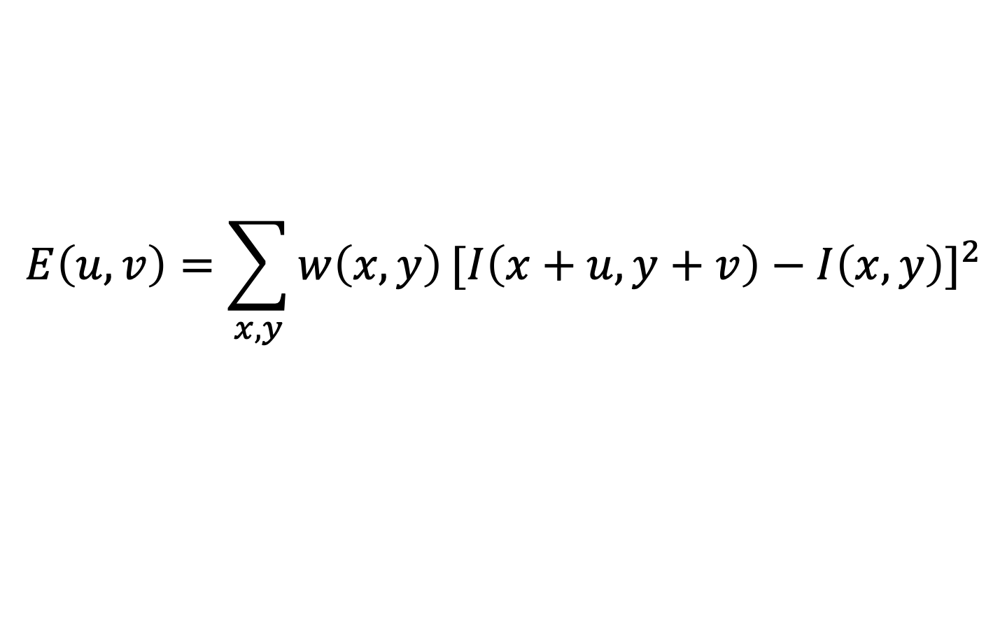
Corner Detection: Mathemathics
$$E\left(u,v\right)=\sum_{x,y}{w\left(x,y\right)}{[I\left(x+u,y+v\right)−I\left(x,y\right)]}^{2}$$
Gaussian for example
Window function
Shifted intensity
Image

Slide 21
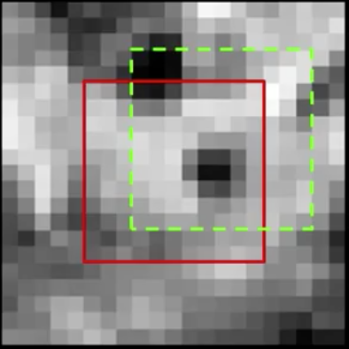
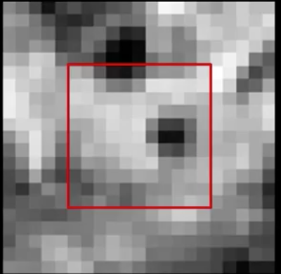

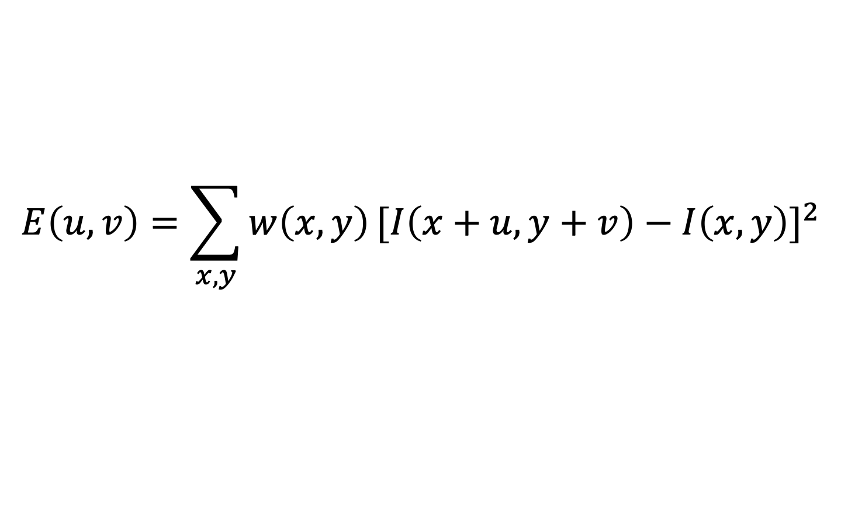
Corner Detection: Mathemathics
Change in apearance for shift [u,v]:
$$E\left(u,v\right)=\sum_{x,y}{w\left(x,y\right)}{[I\left(x+u,y+v\right)−I\left(x,y\right)]}^{2}$$
I(x,y)
E(u,v)
E(3,2)
E(0,0)

Slide 22
Corner Detection: Mathemathics
Change in apearance for shift [u,v]:
$$E\left(u,v\right)=\sum_{x,y}{w\left(x,y\right)}{[I\left(x+u,y+v\right)−I\left(x,y\right)]}^{2}$$
We want to find out how this function behaves for small shifts (u,v near 0,0)
Second-order Taylor expansion of E(u,v) about (0,0) (local quadratic approximation for small u,v)

Slide 23

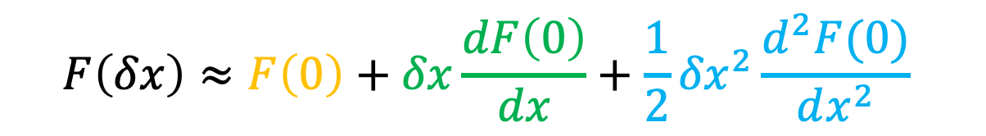
Corner Detection: Mathemathics
Change in apearance for shift [u,v]:
$$E\left(u,v\right)=\sum_{x,y}{w\left(x,y\right)}{[I\left(x+u,y+v\right)−I\left(x,y\right)]}^{2}$$
$$F\left(δx\right)≈F\left(0\right)+δx\frac{dF\left(0\right)}{dx}+\frac{1}{2}{δx}^{2}\frac{d^{2}F(0)}{dx^{2}}$$
E(u,v)$≈E\left(0,0\right)+\left[u v\right]\left[\begin{aligned}E_{u}\left(0,0\right) \\ E_{v}\left(0,0\right)\end{aligned}\right]+\frac{1}{2}\left[u v\right]\left[\begin{matrix}E_{uu}\left(0,0\right) & E_{uv}\left(0,0\right) \\ E_{uv}\left(0,0\right) & E_{vv}\left(0,0\right)\end{matrix}\right]\left[\begin{aligned}u \\ v\end{aligned}\right]$

